Slide 1
ITEc-876 Group E
Prepared by:-
Nandish Patel (45539510)
Tarun Kumar (45534632)
Saikiran Ravula (45539146)

Slide 2
Replication of original work
FastText is a library for the learning of word embeddings and text classification created by Facebook’s AI Research Lab.
We are using Command line to run fasttext on ubuntu16.04(Amazon EC2).
Data used in learning how to work our way around fasttext is “StackExchange questions about cooking” [As provided in the tutorial].
We explored Text classification using all the algorithms(Default supervised method, Word-n-grams, Hierarchical Softmax, and Multi-label Classification) mentioned in the tutorial.
We are exploring Word representations as it can be a potential application for our data set.

Slide 3
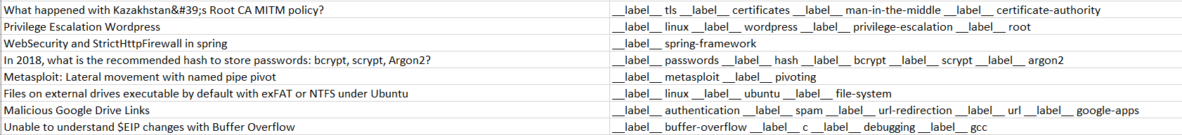
Information security
We will be scraping data from StackExchange group of websites.
The first dataset will be on the topic of “Information Security”.
The data will consist of two columns. One column contains text, named Question, which contains questions regarding Information Security from StackExchange. The second column contains Labels which are generally tags associated with the questions.
The data is multi-label text data.

Slide 4
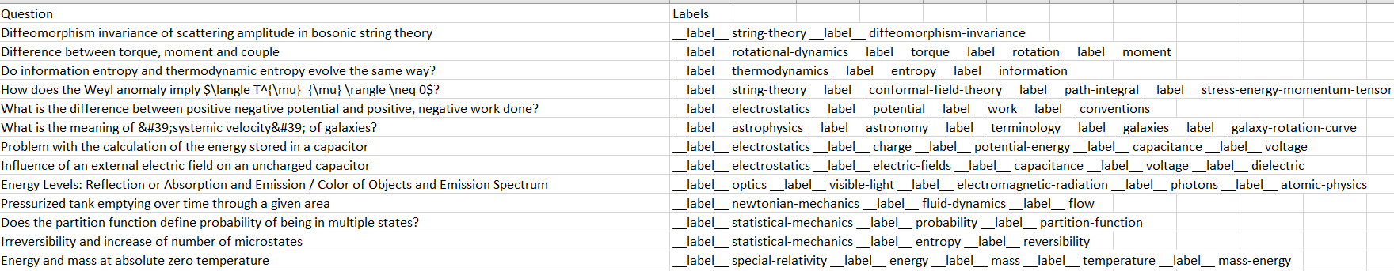
physics
The second dataset will be on the topic of “Physics”.
The data will consist of two columns. One column contains text, named Question, which contains questions regarding Physics from StackExchange. The second column contains Labels which are generally tags associated with the questions.
The data is multi-label text data.

Slide 5
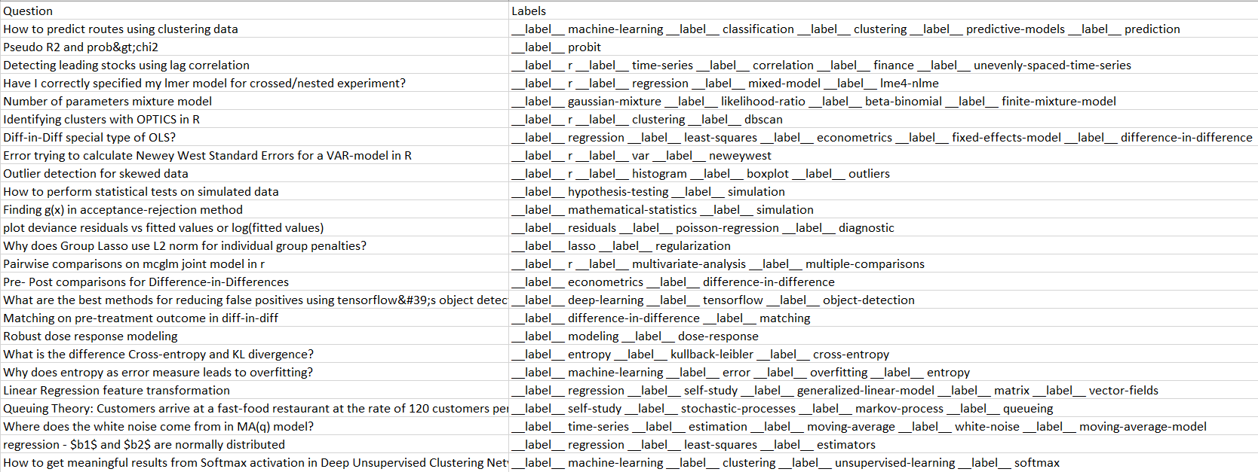
Statistics
The third dataset will be on the topic of “Statistics”.
The data will consist of two columns. One column contains text, named Question, which contains questions regarding statistics from StackExchange. The second column contains Labels which are generally tags associated with the questions.
The data is multi-label text data.

Slide 6
Objectives
All the data is of the same type? Just contextually different?
Data from three different domain will be merged and then it will be divided into three parts.[Train,(70%) Validation(20%), Test(10%)]
Our aim is to check whether model can handle data from various domains and classify text accurately or not.
We will be trying different combinations of hyperparameter settings for creating models.[Epoch, Learning rate, loss function, Choosing the right value of n for word-n-gram and more..]
After creating models we will be assessing them based on their performance on test data[Precision - % of correct predicted labels and Recall - % of labels correctly predicted].
Once all the models are assessed, the WINNER will be declared.

Slide 7
THANK YOU

